Slide 1
Interdependence
Systems are made up of relationships between the parts. The parts depend on each other. This means that the success of the system depends on each part working properly. Without this interdependent relationship the system will not complete its function.

Slide 2
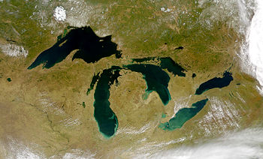
From space some of the lakes of the Great Lakes appear to be disconnected. But ships can move from one lake to another. How is this possible?
Notes:
Source: http://en.wikipedia.org/wiki/Great_Lakes

Slide 3
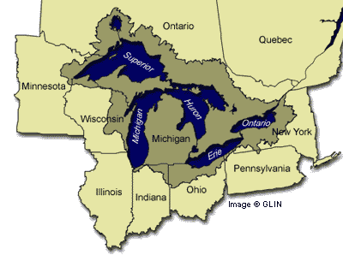
The states that share borders with the Great Lakes together make up the Great Lakes Region. All of these states have similar climate, similar industries, and similar ecosystems.
Notes:
Source: http://www.google.com/imgres?imgurl=http://www.great-lakes.net/teach/chat/answers/graphics/greatlakesmap.gif&imgrefurl=http://www.great-lakes.net/teach/chat/answers/greatlakesmap.html&h=298&w=400&sz=17&tbnid=go1k5VvWo0EJ::&tbnh=92&tbnw=124&prev=/images%3Fq%3Dgreat%2Blakes&usg=__i5ZDXbm5i9p9zZGCebVrKZVfxPw=&sa=X&oi=image_result&resnum=7&ct=image&cd=1

Slide 4
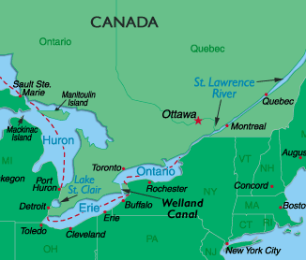
St. Lawrence River/Seaway
This body of water permits the passage of deep-water ships between the Atlantic Ocean and the Great Lakes. It includes a series of man-made canals, locks and dams, and is considered one of the most vital shipping routes on the planet.
Notes:
Source: http://www.worldatlas.com/webimage/countrys/namerica/greatlk.htm
Student article from LAP’s: Explorers of the “Gateway to the Interior”

Slide 5
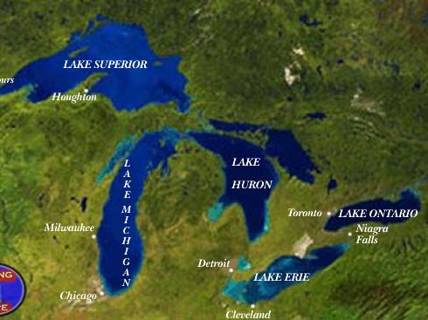
Important, large cities have developed along the Great Lakes. These cities support industries that depend on the interconnected waterways of the Great Lakes.
Notes:
Source: http://www.google.com/imgres?imgurl=http://www.divinglore.com/Genesis/USA/great%2520lakes%2520map.jpg&imgrefurl=http://www.divinglore.com/Genesis/USA/Great_Lakes_%26_Inland_Sites.htm&h=367&w=600&sz=50&tbnid=vfQKQQTtjFwJ::&tbnh=83&tbnw=135&prev=/images%3Fq%3Dgreat%2Blakes&usg=__gt4if3PwwakpkEjUKUk3PscVa2Q=&sa=X&oi=image_result&resnum=5&ct=image&cd=1

Slide 6
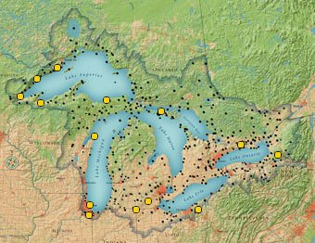
Endangered Ecosystems
Human population growth and industries can cause damage or destroy the ecosystems around the Great Lakes. The Nature Conservancy is one organization that works to protect and preserve these important ecosystems.
Notes:
Source: http://www.nature.org/wherewework/northamerica/greatlakes/preserves/ The Nature Conservancy

Slide 7
Man-Made Waterways
The connections between the Great Lakes become useful waterways to people because of some important man-made waterways.
These waterways allow ships to move people and goods through narrow, shallow areas and around dangerous waterfalls.
Canals, locks and channels connect rivers and lakes that allow travel between the 5 Great Lakes.

Slide 8
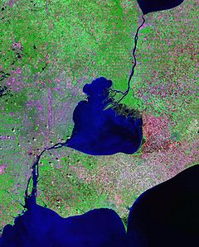
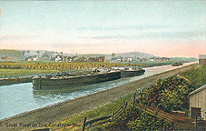
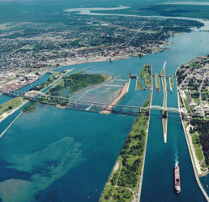
Man-Made Waterways
Canal: an artificial waterway for navigation, irrigation, etc.
Lock: an enclosed chamber in a canal, dam, etc., with gates at each end, for raising or lowering vessels from one level to another by admitting or releasing water.
Channel: the deeper part of a waterway

Slide 9
Interdependence
Systems are made up of relationships between the parts. The parts depend on each other. This means that the success of the system depends on each part working properly. Without this interdependent relationship the system will not complete its function.

Slide 10
Responsibility
Humans depend on these waterways to move resources and products from one place to another.
We also use these waterways as transportation.
The biotic factors within these ecosystems depend on healthy abiotic factors for their survival.
How do we make sure we are making a minimal impact on these ecosystems while we are using them?
Laws
Education
Stewardship

Slide 11
How are the Great Lakes interdependent?
Work in triads to discuss this question.
One person is the recorder.
One person is the reporter.
One person is the time keeper and task manager.
If you finish your discussion early, draw a diagram showing how the Great Lakes are interdependent.

